Slide 1


Exprezza
Barista
21
10
9
22
7
8
19
20
6
Outdoor
5
Smoking Room
17
18
3
4
13
14
Dinding
Pintu masuk
1
2
15
16
11
12

Slide 2
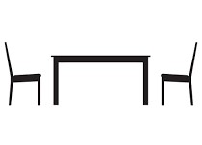
GH Corner
Barista
12
13
11
4
6
5
10
Dinding
2
9
8
1
Pintu masuk/Lt.1
3
Lt.2
7

Slide 3
Outdoor
Raza Kopi
Barista
30
31
28
29
26
24
25
27
6
7
22
23
Dinding
5
20
21
17
19
4
18
16
3
12
14
15
13
Pintu masuk/Lt.1
Lt.2
1
11
2
9
10
8

